Slide 1

Driver Fatigue Detection
Submitted by:
A. Akshitha (18071A0502)
Ch. Sankranthi (18071A0510)
K. Sahithi Latha (18071A0528)
S. Shanmukha Anurag (18071A0551)

Slide 2
Abstract
The main idea behind this project is to develop a non-intrusive system which can detect fatigue of the driver and issue a timely warning. Each year, millions of people lose their life due to traffic accidents around the world.
The solution to prevent or decrease fatigue related accidents, is to ensure that the driver rests frequently. However, the simple fact of the matter is that frequent resting periods cannot be effectively enforced, and as a result there is a need for a system to monitor the level of driver fatigue in real-time.
By monitoring the driver’s movements using a camera and developing an algorithm we can detect symptoms of driver fatigue early enough to avoid an accident. So, this project will be helpful in detecting driver fatigue in advance and will gave a warning output in form of sound and vibration.
For implementing this system several OpenCV libraries are used including Haar-cascade. The entire system is implemented using Raspberry-Pi.

Slide 3
Introduction
Driver fatigue is a significant factor in many vehicle accidents.
There has been ample development in the field of safety in case of accidents in the form of air bags, etc. Because of the hazard that drowsiness presents on the road, methods need to be developed for counteracting its affects.
The aim of this project is to develop a prototype drowsiness detection system. Different methods of eye detection are used to check whether the eyes are open or closed. Based on the time duration the eyes are found to be closed, or the driver yawns it can be determined whether the person is drowsy or not, showing signs of fatigue, an alarm system is triggered.
This alerts the driver to either park the car or consciously regain the composure to drive safely.
This project aims at creating less expensive system as compared to other existing models.

Slide 4
Literature Survey
Driver Fatigue Detection Based on Eye Tracking
A New Real-Time Eye Tracking for Driver Fatigue Detection
Driver Fatigue State Recognition with Pixel Based Caveat Scheme Using Eye-Tracking
A Novel Real-time Face Tracking Algorithm
Driver Fatigue Detection through Pupil Detection and Yawning Analysis

Slide 5
Sno. | Title | Authors | Techniques | Drawbacks | Journal | Year
1 | Driver Fatigue Detection Based on Eye Tracking | Wen-Bing Horng,Chih-Yuan Chen,Yi Chang,ChunHai Fan | Indicate using eyes and eyelashes | Doesn’t analyze head turning and lighting conditions | IEEE | 2004
2 | A New Real-Time Eye Tracking for Driver Fatigue Detection | Zutao Zhang,Jiashu Zhang | Kalman Filter | Produces various estimates which might lead to false data | IEEE | 2011
3 | Driver Fatigue State Recognition with Pixel Based Caveat Scheme Using Eye-Tracking | K. Thulasimani, K. G. Srinivasagan | Pixel Based Caveat Scheme |  | World Academy of Science, Engineering and Technology | 2014
4 | A Novel Real-time Face Tracking Algorithm | Quifen Yangon,Weihua Gui , Huosheng Hu | Generalised Laplacian | No data storage and prediction of health conditions | IRJET | 2018
5 | Driver Fatigue Detection through Pupil Detection and Yawning Analysis | M.V. Narayana, Kalyan Dusarlapudi, K.Uday Kiran, Shakthi Kumar.B | IOT- GSR sensor, MQ135 sensor, Pulse rate sensor and AM2315 sensor | Integration of sensors and analysis of the different sensors' response is complex | JARDC | 2017

Slide 6
Driver Fatigue Detection Based on Eye Tracking
The first and foremost step is to detect the face. Once that is done, the image is binarized. The image is then scanned to detect gray scale value zero (0) - which indicates the eye region.
For more accurate position of eyes, a unique way of calculating slope of lines is presented. This helps ascertain the boundaries of the eye region. Once eyes have been detected, the next step is to find out if the driver is displaying signs of fatigue.
One of the easiest methods to do so is to calculate the number of pixels with gray scale value zero (0) - they indicate presence of eyes and eyelashes. The value, say n, will change depending on eye state. If the driver is dozing, n will vary very slowly i.e. a gradual change in the value of n will be seen. While if the driver blinks, n will change, however the change will be very fast and can thus be disregarded.
The best aspect of this algorithm is that it has been implemented in VC 6.0 on a windows XP platform, like our needs. It is a time saving method and is known to give good results. So, considering this fact, it will be useful to us as we are making a real-time system which must respond quickly and accurately.

Slide 7
A New Real-Time Eye Tracking for Driver Fatigue Detection
The Unscented Kalman filter (UKF) is proposed to track eyes for Driver fatigue detection. Haar algorithm is firstly used to locate the face.
Secondly, the geometric properties and projection technique are used for eye location.
Thirdly, the UKF is used for real time eye tracking method because UKF is of good tracking performance for quick moving target. Finally, driver fatigue can be detected whether the eyes are closed over 5 consecutive frames using vertical projection matching.
Eye Detection- After defining the eye region, we can use geometric properties and projection technique for eye detection. Performing horizontal and vertical projection on the eye region map, the exact position of the eye can be located at the peak. Two peaks which will be detected, one will represent the projection of eyebrow.
UKF FILTER BASED EYE TRACKING- The unscented Kalman filter proposed by Julier and Uhlmann can not only avoid the use of Jacobian matrices, simplifying the implementation of the filter and potentially reducing its complexity.

Slide 8
Eye Tracking and Dynamic Template Matching
Face detection is achieved by the characteristic of skin colours. Since skin colours have quite stable distribution in some colour models, face detection based on skin colour is popular.
The HSI colour model is preferred since intensity changes should not create an obstacle in face detection. So, the face region can now be separated from the image if it crosses this threshold.
Next, the eyes must be located. Here, it is assumed that the possible location of the eyes will be in the block of the upper two fifths of the face region.
Now, in this paper, it is said that it consists of dynamic tracking of the eyes. It means that at time t=0, there is no stored eye template. The first eye template obtained becomes the basis for comparison for the next eye search. Thus, this method ensures that memory requirements are kept to a minimum.
For exact location of eyes, horizontal projection is performed. The eyes are regarded as connected components for rectangular boxes to be drawn around them.
For fatigue detection, eyeballs which appear bright are obtained by inverting the image. By observation, the saturation values of eyeball pixels fall in the range of 0.00 to 0.14. If eyes are closed over five consecutive frames, then the driver is said to be dozing.

Slide 9
A Novel Real-time Face Tracking Algorithm
According to pose of the driver, the system forms either isosceles feature triangle or right feature triangle to acquire potential face region.
Image Processing- RGB image is converted to Y, Cr and Cb colour space. The eye regions have low intensity (Y), low red chrominance (Cr), and high blue chrominance (Cb), when compared to the forehead region of the face. Using this fact, we will preprocess the input image to a gray level image.
Rules for Triangle Formation-For frontal images, we could search the potential face regions that are obtained from the criteria of” the combination of two eyes and one 10 mouth (isosceles triangle)”. For side-view images, we use the rationale of” the combination of one eye, one ear hole, and one mouth (right triangle)”, which is called the Feature Triangle.
For Isosceles triangle- Statistics shows that the Euclidean distance between two eyes is about 90-110 percent of the Euclidean distance between the centre of the right/left eye and the mouth. Using this data, we can form an isosceles triangle on the frontal image.
Steps for above algorithm are as follows: 1. Initialize the image and convert to Y, Cr, Cb 2. Apply feature triangle rules to form isosceles or right-angle triangle 3. Verify the triangle 4. Eliminate Noise.

Slide 10
Driver Fatigue Detection through Pupil Detection and Yawning Analysis
Basic parameters that can be used to evaluate alertness of driver:
1. Drivers’ physiological parameters like brain waves, heart rate, pulse rate and respiration.
2. Driving performance like changes of the steering wheel, vehicle lateral position, driver’s grip force on the steering wheel, acceleration, vehicle speed, acceleration, braking and turning angle.
3. Non-intrusive way, by detecting the eyes- open or close and rate of opening and closing, and mouth- frequency of yawning.

Slide 11
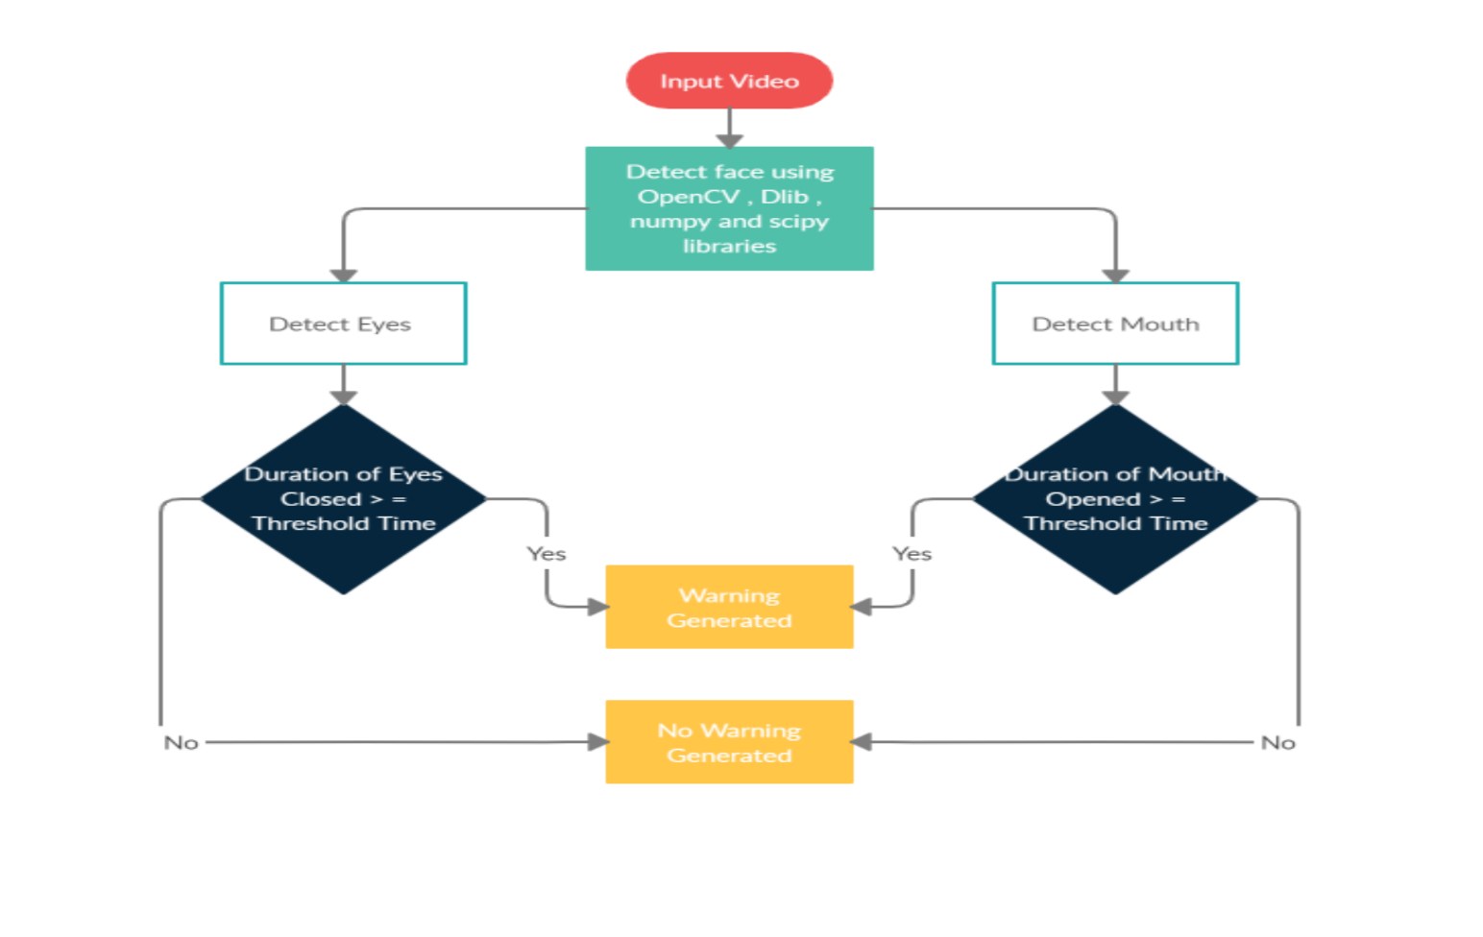
Flowchart representing the proposed approach for Driver Fatigue Detection

Slide 12
System Architecture
User Interface:
Every user may not be skilled at handling the interfaces. Hence the product that we developed used a simple and easy to use GUI Input from user is via keyboard.
Hardware Interface:
The minimum requirements that are required to interact with a simple GUI are well enough to support this product.
Software Interface:
This product is developed in Windows 10 environment using PYTHON. The toolboxes used to develop this product are Image Processing Toolbox and Computer Vision System Toolbox. This project is completely implemented using these two toolboxes.

Slide 13
Hardware and Software Requirements
Hardware Requirements:
Processor: Intel® Core™ i3 2.53 GHz / Above
RAM: RAM 2 GB / Above
HDD: 120 GB / Above
Software Requirements:
Operating System: Windows XP and above
Developing Environment: PYTHON 3.6

Slide 14
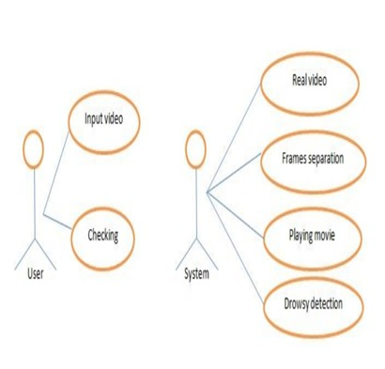
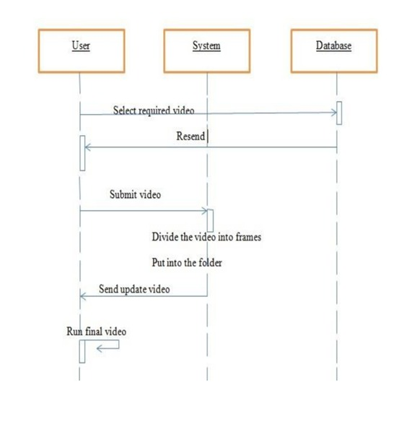
Use Case Diagram for Drowsy Detector
Sequence Diagram for Drowsy Detector

Slide 15
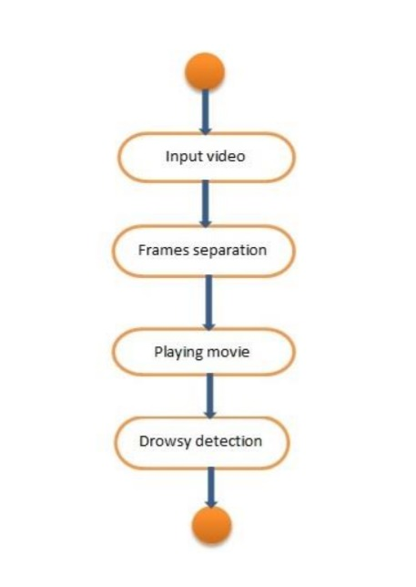
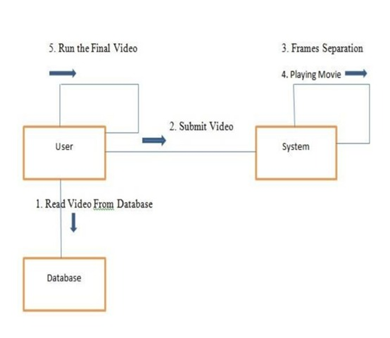
Collaboration Diagram for Drowsy Detector
Activity Diagram for Drowsy Detector

Slide 16
Modules
Face detection
Pupil detection and eye state analysis
Yawning Analysis

Slide 17
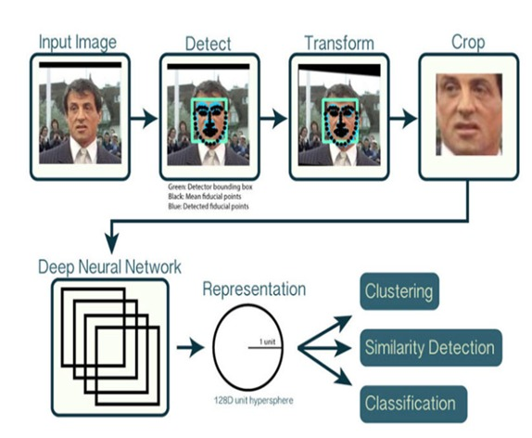
Face Detection
Using RGB values, luminance(Y), blue difference and red difference, Cb and Cr respectively are calculated from image.
These values are then checked if they lie between the empirically calculated ranges of skin colour.
This can later undergo binarization to create an image which is minus the background, thus detecting the face.

Slide 18
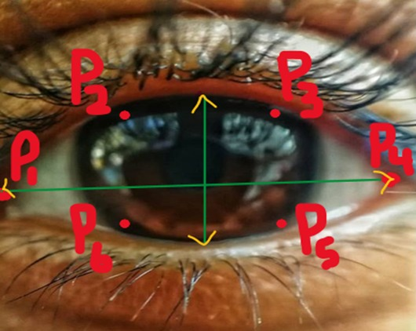
Pupil detection and eye state analysis
Using an IR illuminator, bright and dark image of the pupils are obtained and subtracted to get a difference image and the background is removed. PERCLOS (Percentage of Eyelid Closure Over the Pupil Over Time) principle is used to eye state analysis.
f= [t3- t2] /[t4-t1]
The f is the value of PERCLOS, t1, t2 are the time that eyes closed from the largest to 80 percent, from 80 percent to 20 percent; t3 is the time from 20percent closed to 20percent open, t4 is 20 percent open to 80 percent the amount of time spent.
When used this method to measure state of eyes we use camera to get the image of driver’s face, then we position eyes through image processing methods, at last we analysis and identify the image to confirm that the eyes are open or closed.

Slide 19
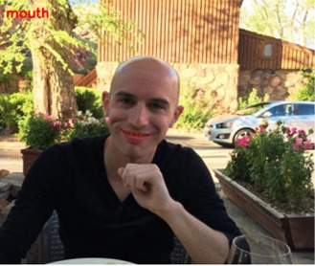
Yawning Analysis
Yawning can be detected from the extent of openness of the mouth. If ratio of mouth height to width is above 0.5, the user is yawning and if more than 6 frames detect yawning, the system points fatigue.
Problems Performance of the IR illuminator is good at night but reduces on bright days. Yawning cannot be detected when the driver puts a hand on his face.

Slide 20
Limitations
Objects in the video, should be uniformly illuminated, else results can differ.
Changing distance of person from the camera can cause problems.
Head lowering can give abrupt results.
The algorithm does not work for the people sleeping with eyes open.

Slide 21
Future Scope
Skin Segmentation
Eye Binarization
Mouth Binarization

Slide 22
Skin Segmentation
An image which taken inside a vehicle includes the driver’s face.
To remove the brightness from the images is second step. Since the skin-tone color depends on luminance, we nonlinearly transform the YCbCr color space to make the skin cluster luma-independent. This also enables robust detection of dark and light skin tone colors.
The main advantage of converting the image to the YCbCr domain is that influence of luminosity can be removed during our image processing.
In the YCbCr domain all information about the brightness is given by the Y component, since the Cb (blue) and Cr (red) components are independent from the luminosity.

Slide 23
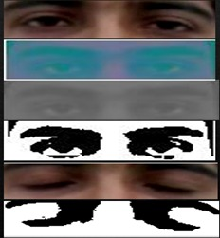
Eye Binarization
After the face is detected using Voila-Jones, the region containing the eyes and mouth must be separated.
After the rectangular window is extracted, we have considered that the eyes are located at (0.25 * height of window) from the top and (0.15 * width of window) from the left.
The size of window is (0.25 * height of window) in height and (0.68 * width of window) in width. After the eyes are cropped the image is converted to YCbCr.
The reason for conversion and way to convert is mentioned in “Skin Segmentation” column. Then image is converted to grayscale and ultimately to binary image by setting a threshold of (minimum pixel value + 10).

Slide 24
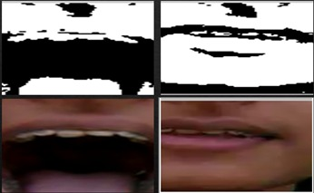
Mouth Binarization
After the face is detected using Voila-Jones, the region containing the eyes and mouth must be separated. After the mouth is cropped the image is converted to YCbCr.
The reason for conversion and way to convert is mentioned in “Skin Segmentation” column.
Then image is converted to grayscale and ultimately to binary image by setting a threshold of (minimum pixel value + 10).

Slide 25
Conclusion
An accuracy of 80 % is achieved using the mentioned methods.
To increase the accuracy to a certain extent, there is another method called skin segmentation which helps to calculate the skin percentage in a frame which also helps us in taking a step forward for cases like head lowering and attention span of the driver on the road.
For this we binarize the video input and calculate the results as shown in the next few slides.
We must increase accuracy of our current model where we use multithreading to hold various aspects into account at the same time.

